Slide 1

Automotive Technology: A Systems Approach, 8e
Chapter 31: Fuel Injection System Diagnosis and Service
Rob Thompson and Jack Erjavec, Automotive Technology: A Systems Approach, 8th Edition. © 2025 Cengage. All Rights Reserved. May not be scanned, copied or duplicated, or posted to a publicly accessible website, in whole or in part.

Slide 2
Chapter Objectives
31.01 Perform a preliminary inspection on a fuel injection system.
31.02 Perform checks of the fuel injection system and related components.
31.03 Service the fuel injection system.
31.04 Inspect and service fuel rails, injectors, and regulators.
31.05 Inspect and service electronic throttle body assemblies.
31.06 Diagnose causes of improper idle speed on vehicles with fuel injection.

Slide 3
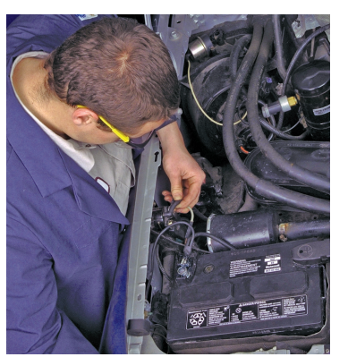
Preliminary Checks
31.01 Perform a preliminary inspection on a fuel injection system.
Before conducting any tests on the injection and engine control systems, be certain of the following:
  The battery is fully charged, with clean terminals and connections.
  The charging and starting systems are operating properly.
  All fuses and fusible links are intact.
  All electrical harnesses are routed properly and their connectors and terminals are free of corrosion and tight.
  The MIL is working properly.
  All vacuum lines are in good condition, properly routed, and attached.

Slide 4
Basic EFI System Checks
31.02 Perform checks of the fuel injection system and related components.
Diagnosis should begin with a check of the MIL; if it stays on or is flashing, the PCM has detected a problem and has set a DTC.
A flashing MIL indicates a catalyst-damaging misfire is occurring.
The absence of a DTC does not mean that the system is operating normally.
A DTC is set only when the PCM sees values that are outside a range or would affect emissions.
Connect a scan tool to the vehicle and retrieve any DTCs.
You should also check the conditions of the OBD II monitors.
Monitors that have not run or did not pass can provide clues to solving the concern.
Use the manufacturer’s recommended test sequences for identifying the cause of the DTC Many fuel injection problems set a fuel trim-related DTC.
Fuel trim should be observed whether or not a DTC was set.

Slide 5
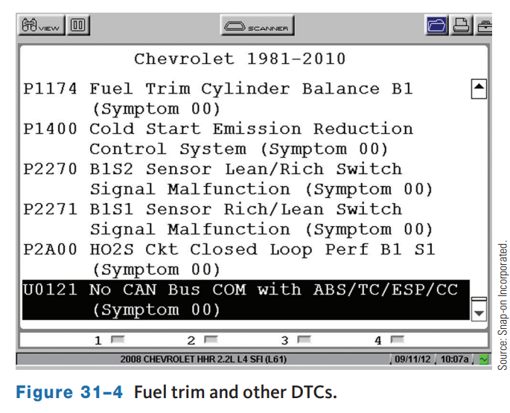
Fuel Trim
The fuel injection system can provide limited corrections for changes in conditions.
The fuel system monitor tracks the amount of these corrections.
The corrections to base or programmed injection pulse width and timing are called short-term fuel trim (STFT) and long-term fuel trim (LTFT).
Fuel trim may also be displayed as equivalency ration (EQ RAT) or as lambda.
The fuel trim monitor is a continuous monitor that looks at the sum of the STFT and LTFT to assess its ability to control the air–fuel ratio.

Slide 6
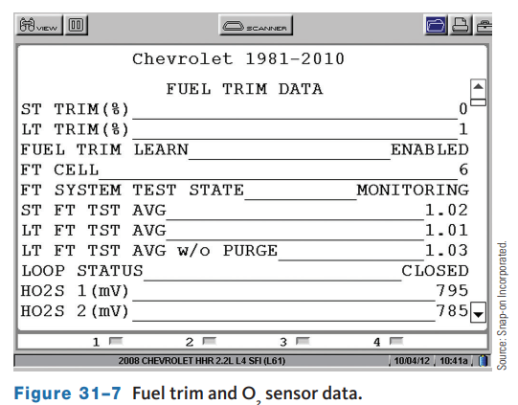
Oxygen Sensor Diagnosis
The activity of an O₂ sensor can be monitored with a lab scope.
The scope is connected to the sensor in the same way as a voltmeter.
The switching of the sensor should be seen as the sensor signal goes to lean to rich to lean continuously.
If the pattern toggles at high voltages, there is a rich condition.
With a lean mixture, the pattern will toggle at low voltages.
The activity of the sensor can typically be monitored on a scan tool.

Slide 7
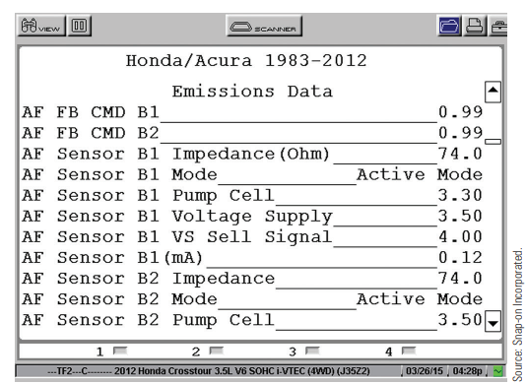
A/F Sensors
The signals from air–fuel ratio sensors are different from those of a conventional O₂ sensor.
This is because A/F sensors produce a current that is interpreted by the PCM.
Reading A/F sensor data may be possible using generic OBD II data or you may need to use EOBD data depending on the scan tool being used.
When some of these sensors are looked at with an OBD II generic scan tool, the voltage range will appear the same as a conventional O₂ sensor, 0 to 1 volt.
Because an A/F sensor operates differently, the normal toggling of the voltage does not appear.

Slide 8
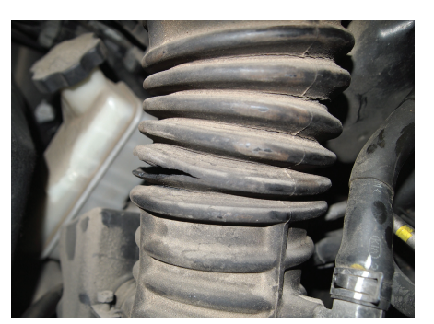
Air Induction System Checks
In a fuel injection system (particularly designs that rely on airflow meters or mass airflow sensors), all the air entering the engine must be accounted for by the air measuring device.
If it is not, the air–fuel ratio becomes overly lean.
During a visual inspection of the air control system, pay close attention to these areas, looking for cracked or deteriorated ductwork.
Check in between the ribs of induction hoses for cracks.
Small cracks in these areas may only cause a problem as the engine moves during operation.
Also make sure that all induction hose clamps are tight and properly sealed.

Slide 9
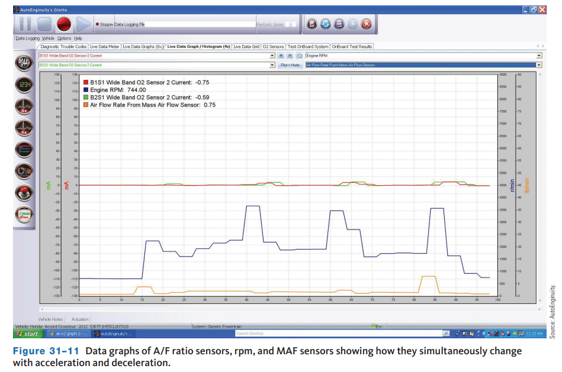
Airflow Sensors
Mass Airflow Sensors
  MAF sensors measure intake air before it reaches the throttle plate.
  If any air bypasses the sensor and enters the combustion chambers without being measured, the engine will run lean.
  A vacuum leak or a leak between the MAF and throttle plate will also reduce fuel delivery.
  The resulting lean mixture will cause the PCM to store DTCs indicating excessive fuel corrections and/or lean misfires.
  The action of a MAF can be observed on a lab scope.

Slide 10
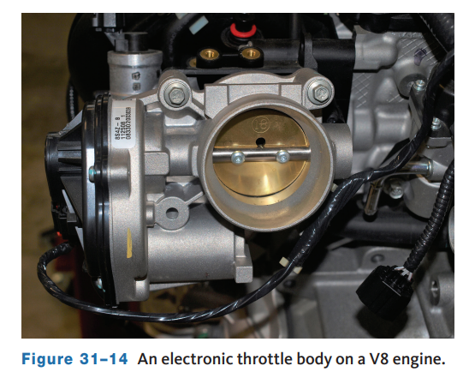
Throttle Body
31.05 Inspect and service electronic throttle body assemblies.
The throttle body allows the driver to control the amount of air that enters the engine, thereby controlling the speed of the engine.
Each type of throttle body assembly is designed to allow a certain amount of air to pass through it at a particular amount of throttle opening.
If anything accumulates on the throttle plates or in the throttle bore, the amount of air that can pass through is reduced.
This normally causes an idle problem.
These deposits can be cleaned off the throttle assembly and the airflow through them restored.

Slide 11
Throttle Body Removal and Cleaning
Whenever it is necessary to remove the throttle body assembly for replacement or cleaning, make sure you follow the procedures outlined by the manufacturer.
Throttle bodies often have coolant circulating through them so it may be necessary to drain coolant from the radiator before removing the throttle body.
Once the assembly has been removed, remove all nonmetallic parts such as the TP sensor, IAC valve, throttle opener, and the throttle body gasket from the throttle body.
Now it is safe to clean the throttle body assembly in the recommended throttle body cleaner and blow dry with compressed air.
Blow out all passages in the throttle body assembly.
Before reinstalling the throttle body assembly, make sure all metal mating surfaces are clean and free from metal burrs and scratches.
Make sure you have new gaskets and seals for all sealing surfaces before you begin to reinstall the assembly.

Slide 12
Fuel System Checks
Remove the air cleaner, crank the engine, and the injector should be spraying some fuel. It is impossible to visually check the spray pattern and volume of port system injectors.
However, performing simple fuel pressure and fuel volume tests will give an accurate evaluation of the fuel delivery system.
Keep in mind that fuel pressure affects the output of a fuel injector: If an injector has the same pulse rate but receives low pressure there is less fuel; if the pressure is high, the amount of fuel increased.
If fuel pressure is now within specifications, the fuel return line is blocked.
If pressure is still high, the pressure regulator is faulty.
If fuel pressure is within specs but the pressure bleeds down, there may be a leak in the fuel pressure regulator, the fuel pump check valve, or the injectors themselves.
Hard starting is a common symptom of internal system leaks.
Also, fuel starvation and lean conditions can occur when the injectors drain the fuel rail faster than the fuel pump can fill it.

Slide 13
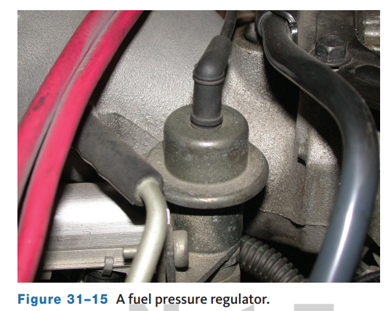
Injector Checks
A cause of a rich mixture is a leaking fuel pressure regulator.
If the diaphragm of the regulator is ruptured, fuel will move into the intake manifold through the diaphragm, causing a rich mixture.
The regulator can be checked by using two simple tests.
After the engine has been run, disconnect the vacuum line to the fuel pressure regulator.
If there are signs of fuel inside the hose or if fuel comes out of the hose, the regulator’s diaphragm is leaking and it should be replaced.
The regulator can also be tested with a hand-operated vacuum pump.

Slide 14
Knowledge Check (1 of 2)
When inspecting a fuel pressure regulator, if there are signs of fuel inside the hose or if fuel comes out of the hose when disconnected, what should be done?

Slide 15
Knowledge Check Answer (1 of 2)
  Answer: If there are signs of fuel inside the hose or if fuel comes out of the hose, the regulator’s diaphragm is leaking and it should be replaced.

Slide 16
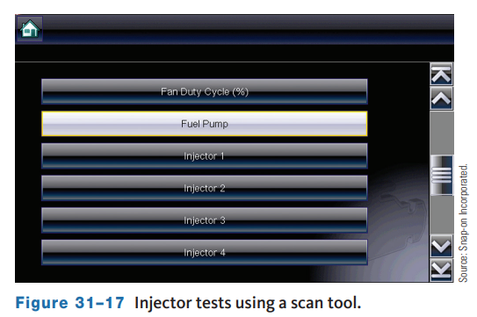
Injector Balance Test
If the injectors are electrically sound, perform an injector pressure balance test.
This test will help isolate a clogged or dirty injector.
With most vehicles, the on-board computer system has an injector test mode accessible through a scan tool.
If the vehicle does not have an injector test mode, an electronic injector pulse tester is used for this test.
As each injector is energized, a fuel pressure gauge is observed to monitor the drop in fuel pressure.
The tester is designed to safely pulse each injector for a controlled length of time.

Slide 17
Oscilloscope Checks (1 of 2)
An oscilloscope can be used to monitor the injector’s pulse width and duty cycle when an injector-related problem is suspected.
The pulse width is the time in milliseconds that the injector is energized.
The duty cycle is the percentage of on-time to total cycle time.
To check the injector’s firing voltage on the scope, a typical hookup involves connecting the scope’s positive lead to the injector supply wire and the scope’s negative lead to an engine ground.
Fuel injection signals vary in frequency and pulse width.
The pulse width is controlled by the PCM, which varies it to control the air–fuel ratio. The frequency varies depending on engine speed.
The higher the speed, the more pulses per second there are.
Most often the injector’s ground circuit is completed by a driver circuit in the PCM.
All of these factors are important to remember when setting a lab scope to look at fuel injector activity.

Slide 18
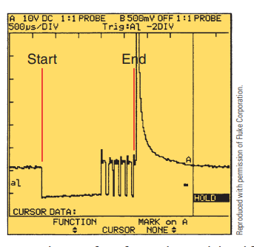
Oscilloscope Checks (2 of 2)
A pulse-modulated injector circuit uses high current to open the injector.
This allows for quick injector firing.
Once the injector is open, the circuit ground is pulsed on and off to allow for a long on-time without allowing high current flow through the circuit.
To measure the pulse width of this type of injector, measure from the drop on the left to the beginning of the large voltage spike, which should be at the end of the pulses.

Slide 19
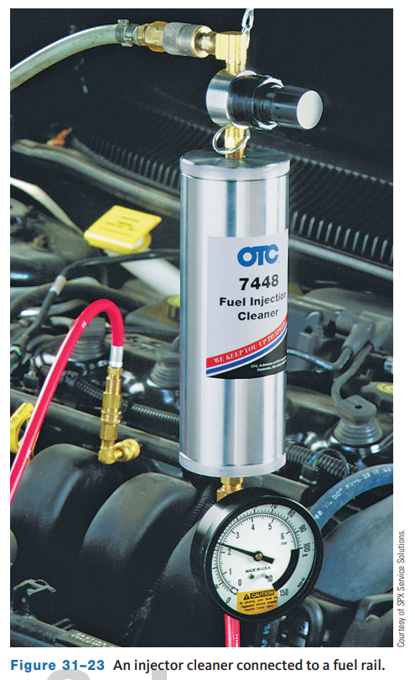
Injector Service
31.03 Service the fuel injection system.
Injector Cleaning
  A chemical solution is placed in a holding container and pressurized by hand pump or shop air to a specified operating pressure.
  The injector cleaning solution is poured into a canister on some injector cleaners and shop air supply is used to pressurize the canister to the specified pressure.
  The injector cleaning solution contains unleaded fuel mixed with injector cleaner.
  The container hose is connected to the Schrader valve on the fuel rail.
  Disable the fuel pump according to the car manufacturer’s instructions.

Slide 20
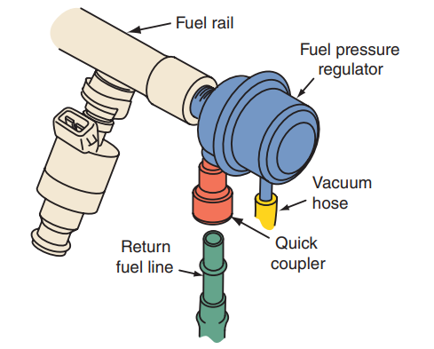
Fuel Rail, Injector, and Pressure Regulator Removal
31.04 Inspect and service fuel rails, injectors, and regulators.
The system must be relieved of all pressure before the fuel lines are opened to remove any of the components.
Before removing the fuel rail, use compressed air to blow dirt and debris from around where the injectors pass through the intake and wipe off any dirt from the fuel rail with a shop towel.
Then loosen the fuel line clamps on the fuel rail, if so equipped.
If these lines have quick-disconnect fittings, grasp the larger collar on the connector and twist in either direction while pulling on the line to remove the fuel supply and return lines.

Slide 21
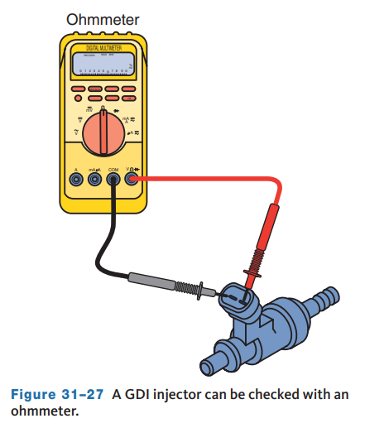
Special GDI Checks
The injectors in a GDI system are best checked with an ohmmeter.
Resistance checks can identify if the injector has an open or a short.
If an injector does not have the specified resistance, it should be replaced.
There are also designated DTCs that may lead you to suspect a problem with an injector.
Those DTCs are related to particular injectors, unless the malfunction is something that affects many of them.
Because GDI operates under very high pressures, a typical fuel volume check on the high-pressure pump should not be done.

Slide 22
Discussion
Fuel injector tests vary from leak checks, to balance tests, to oscilloscope testing.
Have a class discussion while providing several examples of how you would select which test to use based on a particular symptom and why.

Slide 23
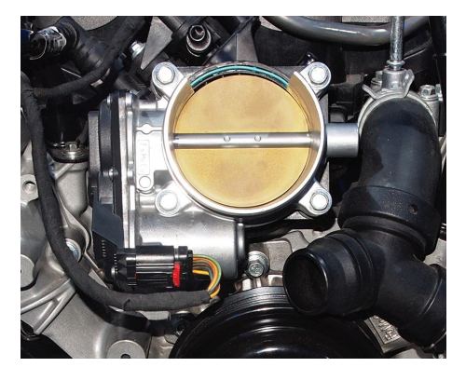
Electronic Throttle Controls
An electronic throttle control (ETC) system normally includes a throttle actuator or motor, TP sensors, accelerator pedal position (APP) sensors, an electronic throttle control module, and a relay.
The control module may be part of the PCM or may be a separate unit.
The actuator responds to commands from the PCM.
The ETC system relies on redundant inputs and processors.
Two accelerator pedal position signals are sent to the PCM, each having a different voltage range.
The PCM processes these signals along with other inputs to set the throttle plate at the required position.

Slide 24
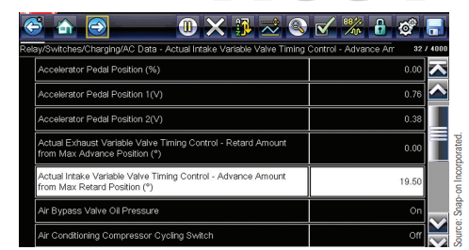
Diagnostic Monitors
The PCM monitors the voltage levels of the APP sensors, TP sensors, and the throttle motor circuit.
It also monitors the return rate of the two return springs. The APP sensors are potentiometers mounted at the accelerator pedal.
Depending on the vehicle, there can be two separate APP sensors or one sensor capable of sending two separate signals.
One signal is used to define the position of the pedal. The signal varies between 0 and 5 volts according to the pedal’s position.
The other signal is used to monitor the sensor itself.

Slide 25
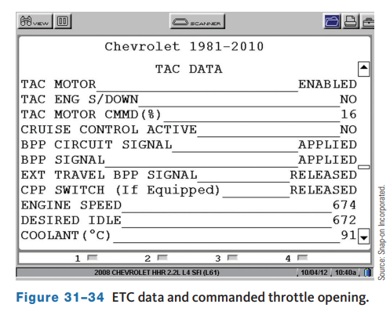
Idle Speed
The best way to monitor idle speed is with a scan tool.
Connect the scan tool to the DLC and make sure there is communication between the tool and the vehicle.
Start the engine and make sure accessories are off.
Increase the speed to about 3,000 rpm and hold it there until the cooling fan turns on.
Allow the engine to idle; check the idle speed and compare it to specs.
Then turn on some heavy load accessories, such as MAX air conditioning with the blower on high and the high-beam headlights.
Check the idle speed and ETC.

Slide 26
General Diagnostics
There are several DTCs assigned to problems with the ETC system.
All of the major components have several DTCs assigned to them.
There are also pinpoint tests for each component.
Most of the components can be checked with a voltmeter, ohmmeter, scan tool, or scope.
The parts should be inspected prior to testing.
This is especially true of the throttle body assembly.
It should be checked for any buildup of dirt on the plate and in the bores. If needed, clean the assembly.
Also make sure that the plate moves freely in the bore.
Ohmmeter checks are made across specific terminals at the throttle body.
On most units, the connection is made across the positive (M+) feed to the motor and the negative (M−) terminals.
This setup measures the resistance of the windings in the actuator’s motor.

Slide 27
Idle Speed Checks
31.06 Diagnose causes of improper idle speed on vehicles with fuel injection.
The idle speed of fuel-injected engines without an electronic throttle is regulated by controlling the amount of air that bypasses the airflow sensor or throttle plates.
When one of these vehicles has an idling problem, check the linkage and vacuum lines before going any further with your diagnosis.
Although idle speed is not typically adjustable, some engines do have provisions for setting the speed.
Always refer to the decal in the engine compartment to identify the conditions that must be present before adjusting the speed.
Also, refer to the service information before making any adjustments.
The idle speed and quality for most engines are controlled by the PCM through the IAC.

Slide 28
IAC Checks
If the idle speed is not within specifications, look at the system with a scan tool.
Make sure there is proper communications between the scan tool and the vehicle.
Make sure that all CAN communications are good.
Many different inputs will affect the performance of the IAC as well as cause other driveability problems.
Following are examples:
  With higher-than-normal TP signals at idle, the PCM interprets this as the throttle being opened and will close the IAC to decrease idle speed.
  If the resistance of the ECT is too high, a higher-than-normal voltage signal is sent to the PCM, which interprets this as a cold engine. The PCM will then open the IAC to increase speed.
  If the resistance of the ECT is too low, a lower-than-normal voltage signal is sent to the PCM, which interprets this as a hot engine. The PCM will then open the IAC to increase speed.

Slide 29
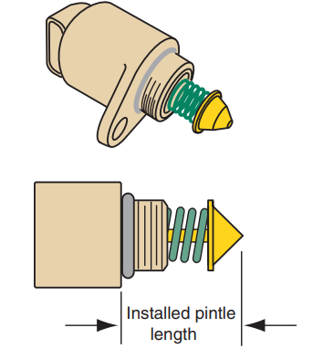
Servicing the IAC Motor
Remove the motor from the throttle body, and inspect the throttle body air passage for carbon deposits.
If there are heavy carbon deposits, remove the complete throttle body for cleaning.
Clean the IAC air passage, motor sealing surface, pintle valve, and pintle seat with throttle body cleaner replace the motor.
If a new IAC motor is installed, make sure that the part number, pintle shape, and diameter are the same as those on the original motor.
Measure the distance from the end of the pintle to the shoulder of the motor casting.

Slide 30
Knowledge Check (2 of 2)
What is the best tool for checking idle speed?

Slide 31
Knowledge Check Answer (2 of 2)
Answer: The best way to monitor idle speed is with a scan tool.

Slide 32
Chapter Reflection
Please take a moment to review what you have learned about EFI diagnosis and service. Then respond to the following questions in one or two paragraphs. Use 150–200 words in your reflection.
What did you struggle to understand most about testing and service of the EFI system? What will you do to better understand these concepts?
Considering all you have learned about EFI service and diagnosis, do you feel prepared to perform the diagnosis and service in a shop or lab setting? How can you better prepare?

